Slide 1
Notes Checker
By Stephen Halligan , Adam Moen and Edosa Osarenotor

Slide 2
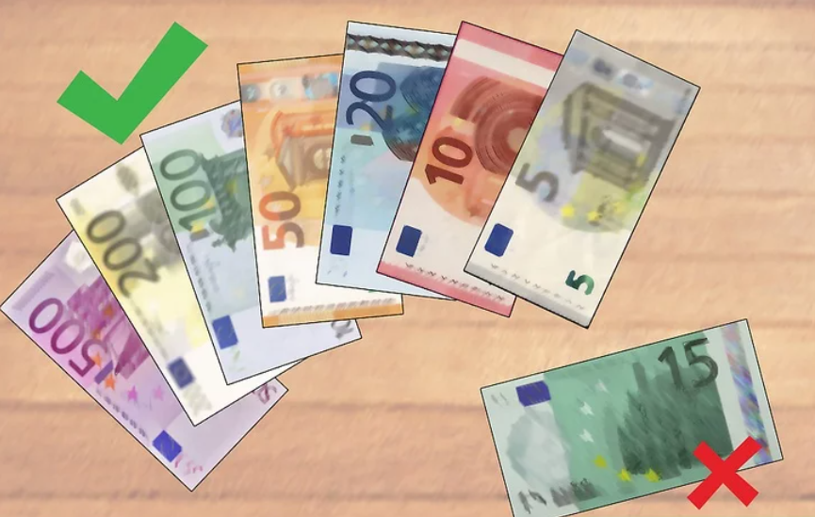
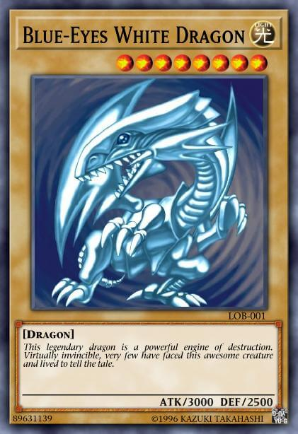
Brainstorming
Emotion / Gesture Identifier
Fake Currency Detection
Notes Checker

Slide 3

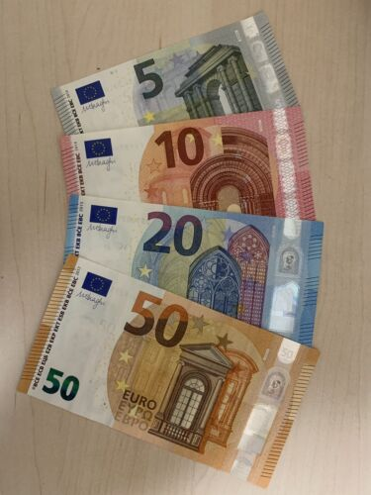
The Theory
Program will check user inputted euro note(s).
These checks include the value of note(s) and if it is a legitimate note
The program will inform the user, the value of the note(s) inputted and if it can be verified.

Slide 4
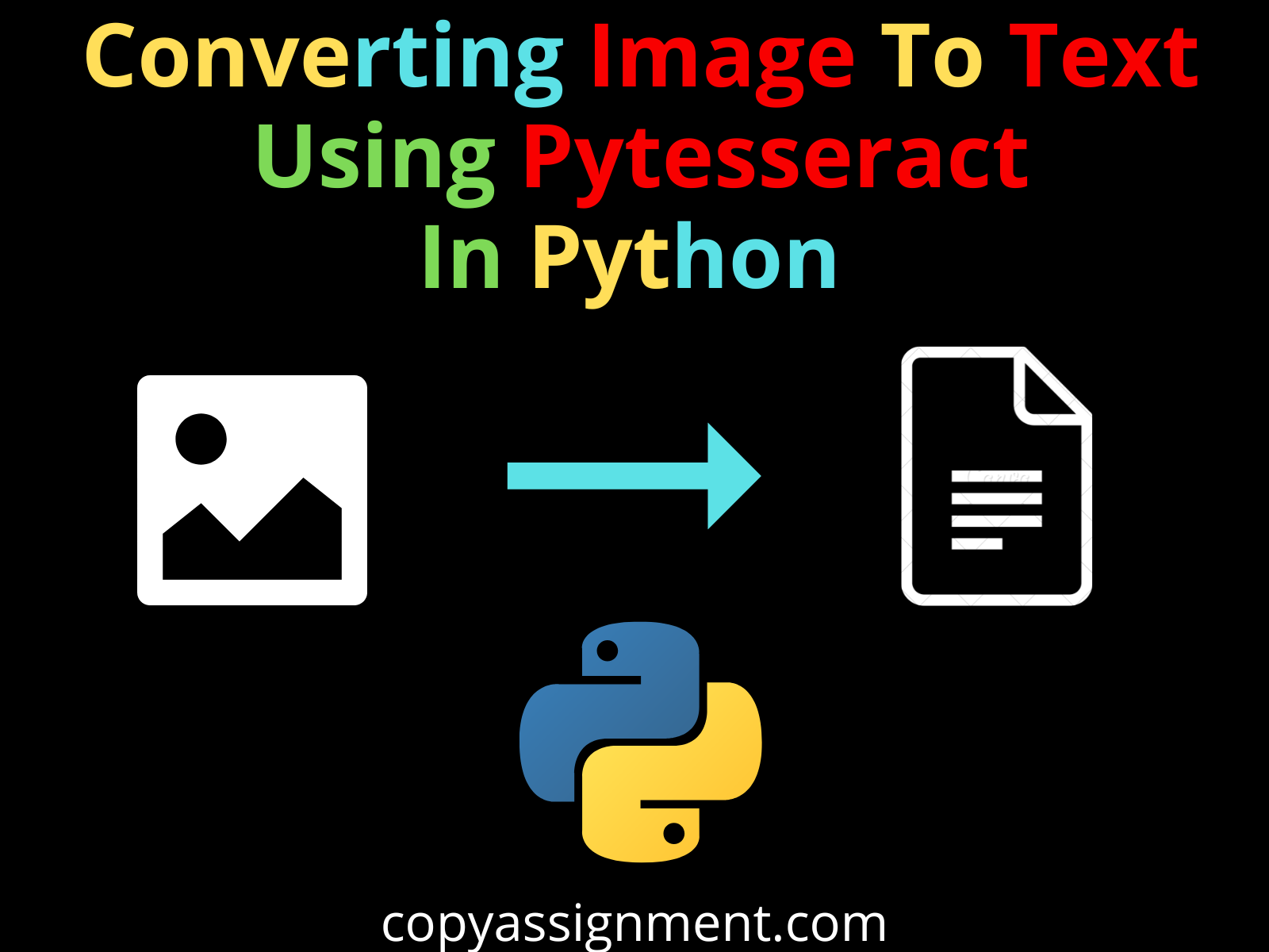
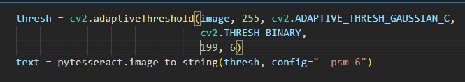
Research
Python-tesseract is an optical character recognition (OCR) tool for python.
That is, it will recognize and “read” the text embedded in images.
Useful for us, as we are extracting information from notes.
Source:
‘Tesseract OCR in Python with Pytesseract & OpenCV’, Nanonets AI & Machine Learning Blog, Aug. 09, 2022. https://nanonets.com/blog/ocr-with-tesseract/ (accessed Nov. 24, 2022).

Slide 5
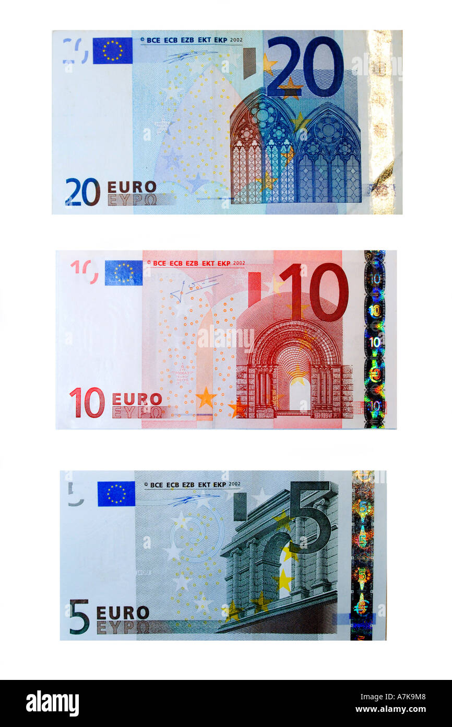
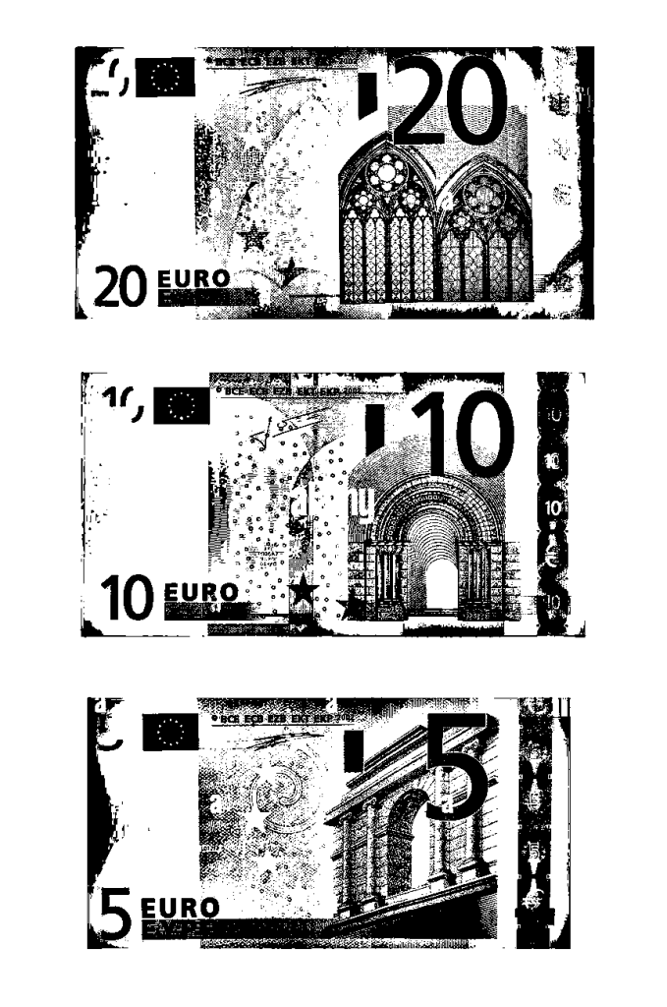
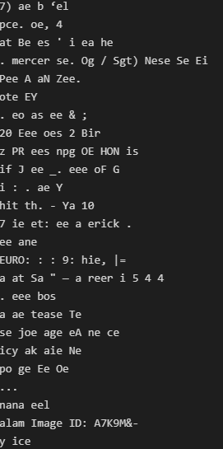
Text Extraction using PyTesseract
Notes:
Explain how we needed to find the right threshold in order to achieve desired outcome

Slide 6
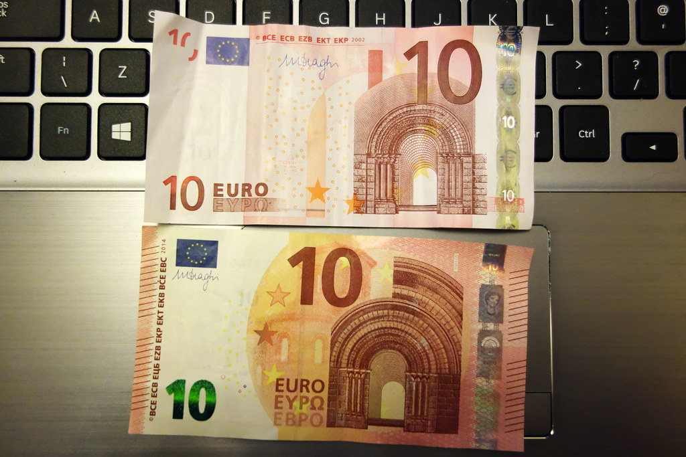
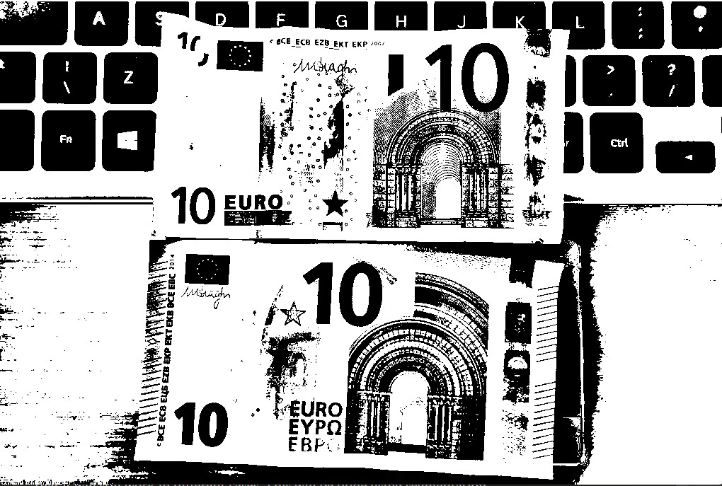
Text Extraction Using PyTesseract

Slide 7
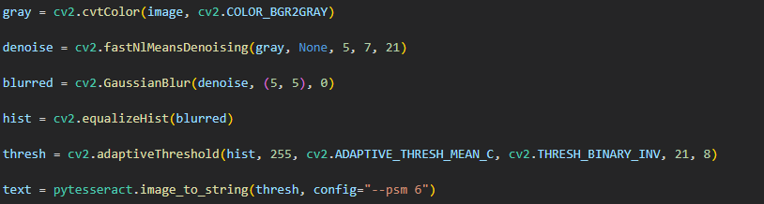
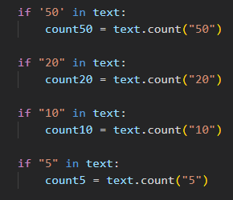
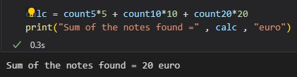
Note Calculation
Notes:
Explain algorithm of how it goes from extracting text to calculation

Slide 8
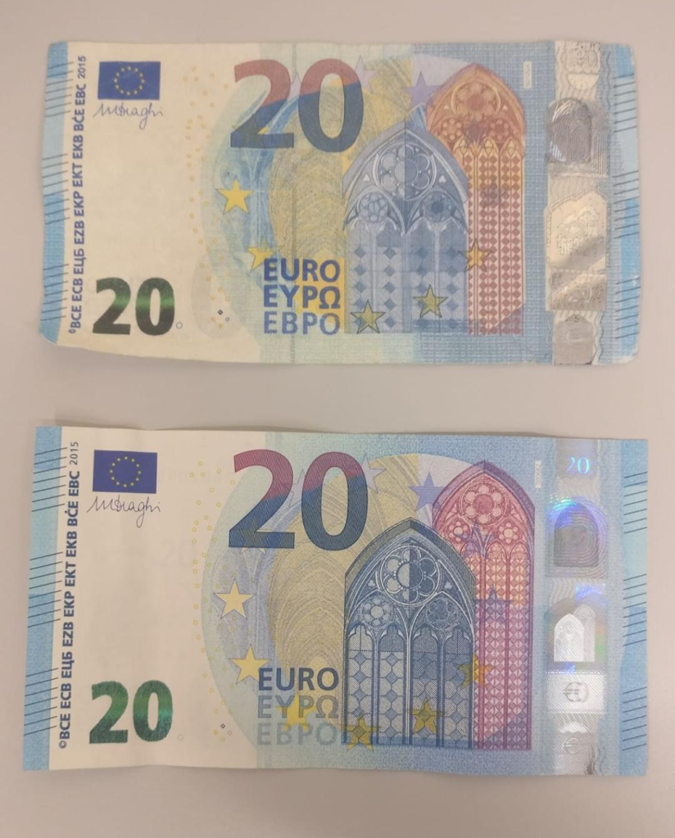
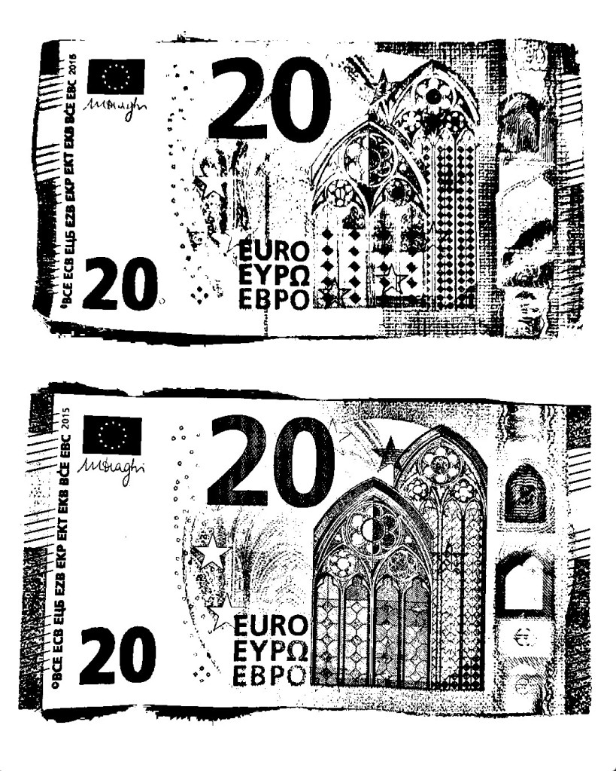
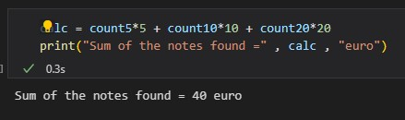
Notes:
Another example with slightly different lighting

Slide 9
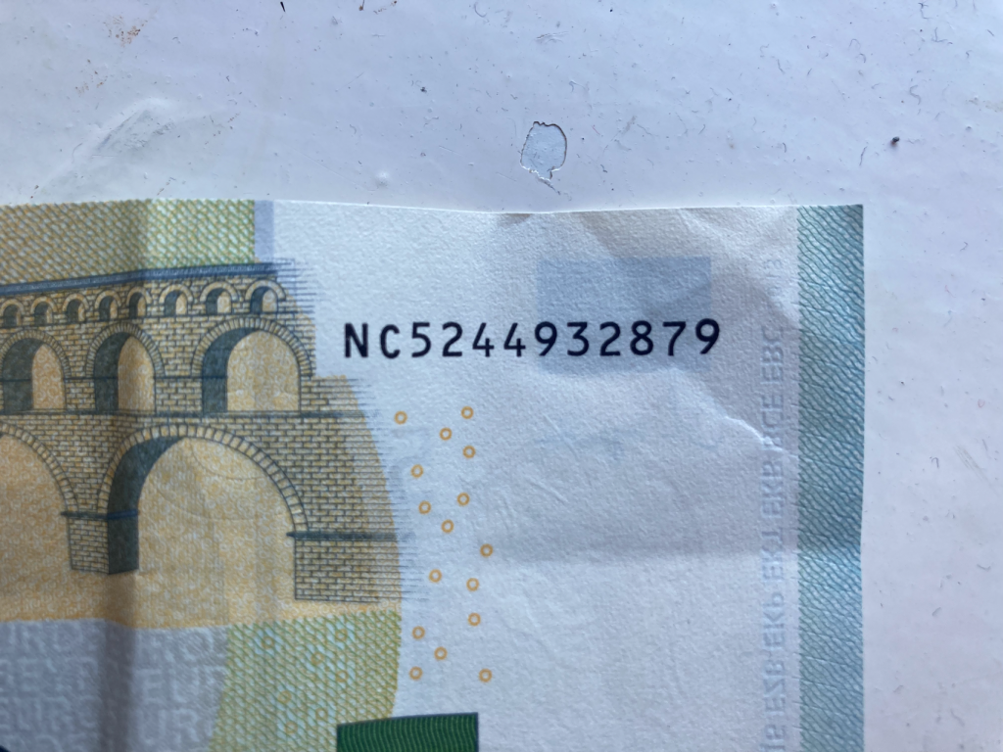
Serial Number Checker
Checksums used within serial numbers to validate the note against the country control
We also use ASCII to convert the 2nd letter to number prior to checksum validation
Country code (first letter of serial number) is also used to validate the authenticity

Slide 10
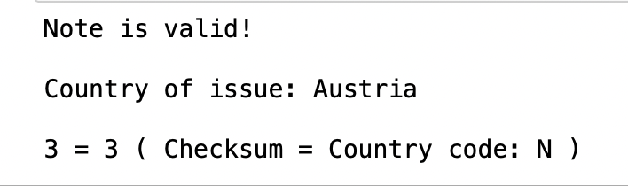
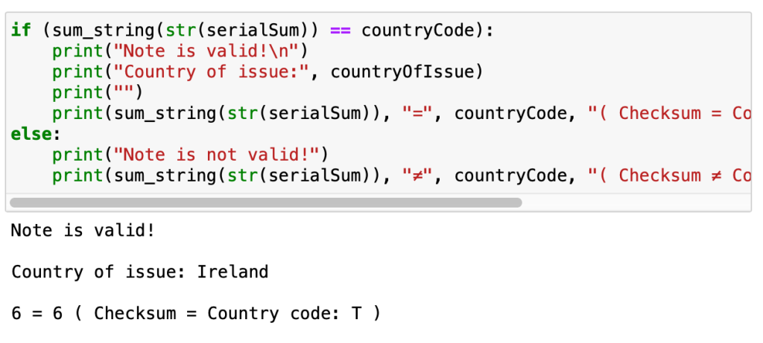
Serial Number Checker Example
Let's take the serial code 'NC5244932879'
To perform calculations on the serial number, get the ASCII of C (67). Perform a checksum on 67, and 5244932879
This gives us a result of 66. We then apply this to mod9, giving us '3'
Now, we compare 3 to the control code of the serial number, 'N'.
The 'N' control code equates to 3.
As our checksum total and control code number are equal, we can say that the note serial number is validated!

Slide 11
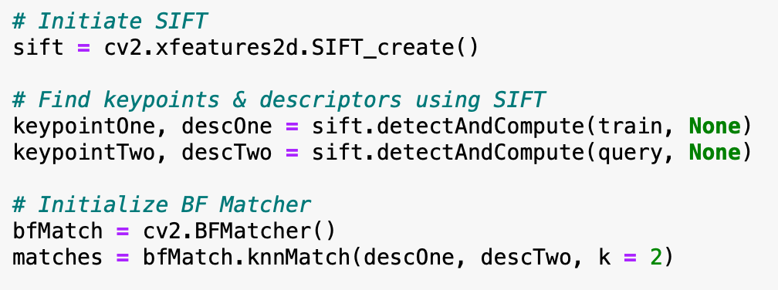
SIFT Image Comparison
SIFT is an algorithm that uses descriptors and key points to compare 2 images against each other
We believe that this would be the most lightweight way to check the validity of a note
For our program, we use SIFT to compare an input banknote to a control image, which is a high-quality photo of a banknote of the same value
Advantages of SIFT
Not affected by scaling
Image brightness doesn't affect output
Not impacted by image rotation

Slide 12
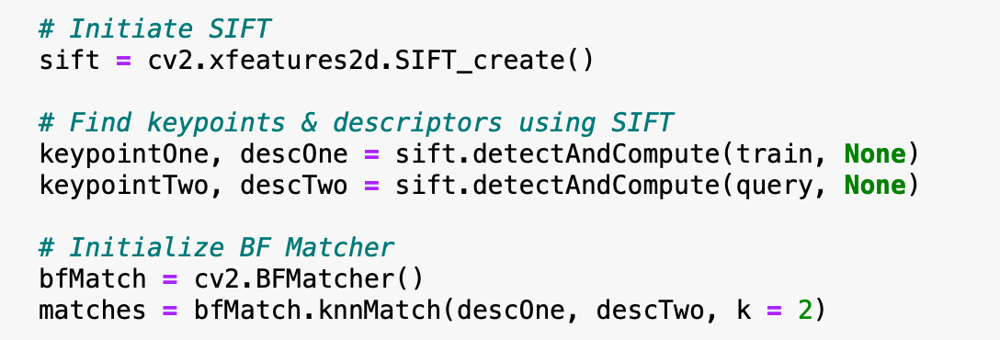
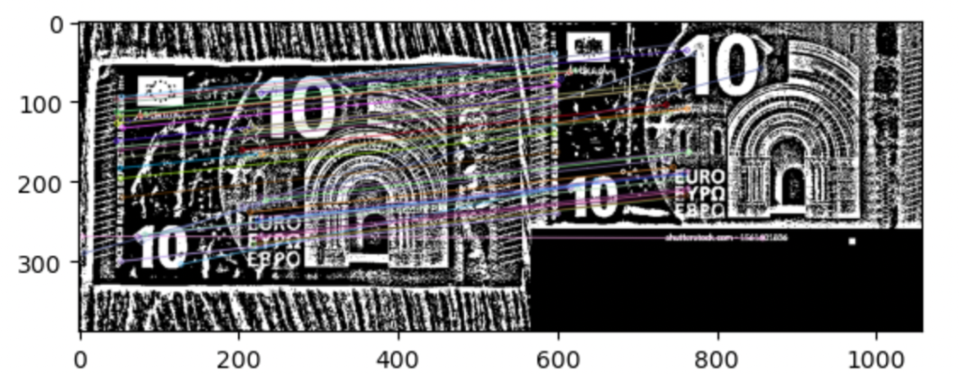
SIFT Image Comparison
A key point in this function is the pre-processing of the images in order to apply the SIFT function.
To first tell what note is being inputted, we use OpenCV functions such as blurring, denoising, equalizing histograms
When run, we get the following output. The images are compared based on the key points present in both images!
After some research, it was found that we can get a comparison of the 2 images based on key points.

Slide 13
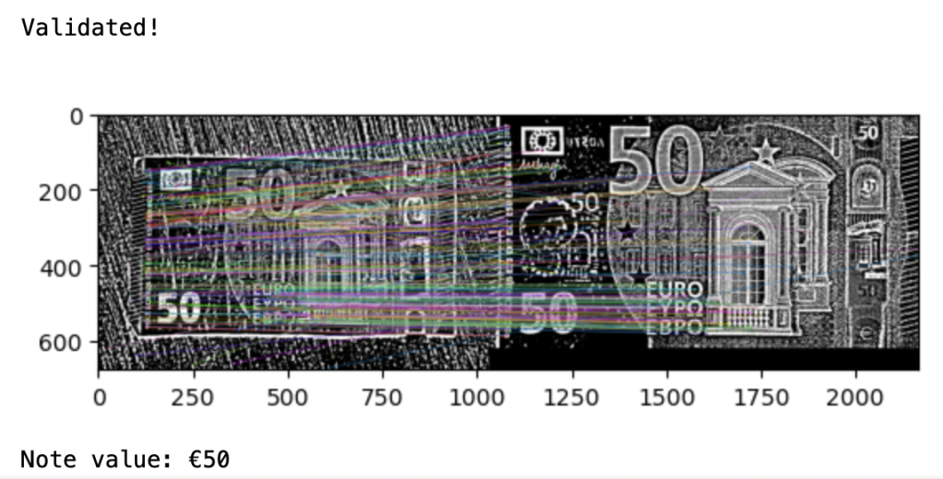
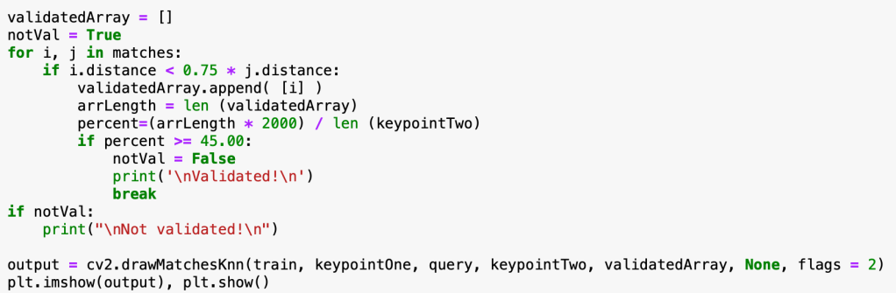
SIFT Comparison Percentages
We can get a comparison of the 2 images based on key points.
Seen in the bottom screenshot, if the calculated percentage is greater than 45%, we consider the note to be valid.
However, if the percentage is lower than 45%, the note is invalid.
Can request the user to input a new photo or perform further checks to ensure their note is not counterfeit.

Slide 14
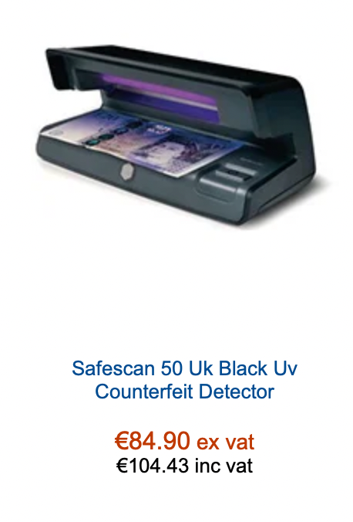
Existing Solutions and Comparisons
Websites like ’http://eurochecksum.altervista.org’ exist for checking serial numbers present on bank notes, however this website is merely a proof-of-concept, and does not utilise image processing.
Fake currency detecting machines currently use UV light to crosscheck the UV marks present on bills, confirming that they are present and are authentic.
These machines can be very expensive and are also, like any method, prone to failing to detect fake currency; depending on how well made the fraudulent note is

Slide 15
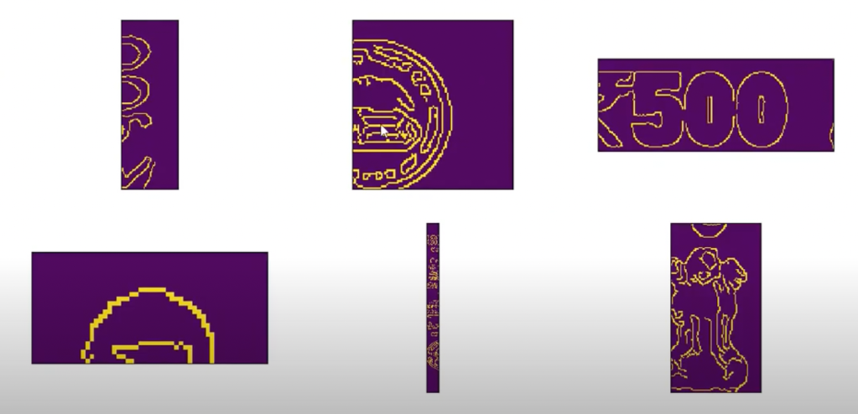
Existing Solutions and Comparisons
Many image processing projects created to detect the validity of bank notes make use of machine learning. Whilst we recognise that this method is very successful at identifying fake currency, it is also not particularly feasible for our project.
Machine learning can be used and yields a very accurate result as can be seen in projects created in the past. This approach is highly resource intensive, and time-consuming to carry out.
https://www.kaggle.com/code/databeru/detect-counterfeit-banknotes-with-machine-learning
https://www.researchgate.net/publication/340305632_Deep_Learning-Based_Fake-Banknote_Detection_for_the_Visually_Impaired_People_Using_Visible-Light_Images_Captured_by_Smartphone_Cameras

Slide 16
Thank you for your attention!
Questions?

